Slide 1

H2O Machine Learning and Kalman Filters for Machine Prognostics
Hank Roark
@hankroark
hank@h2o.ai

Slide 2
WHO AMI I
Lead, Customer Data Science @ H2O.ai
John Deere: Research, Software Product Development, High Tech Ventures
Lots of time dealing with data off of machines, equipment, satellites, weather, radar, hand sampled, and on.
Geospatial, temporal / time series data almost all from sensors.
Previously at startups and consulting (Red Sky Interactive, Nuforia, NetExplorer, Perot Systems, a few of my own)
Engineering & Management MIT Physics Georgia Tech
hank@h2oai.com @hankroark https://www.linkedin.com/in/hankroark

Slide 3
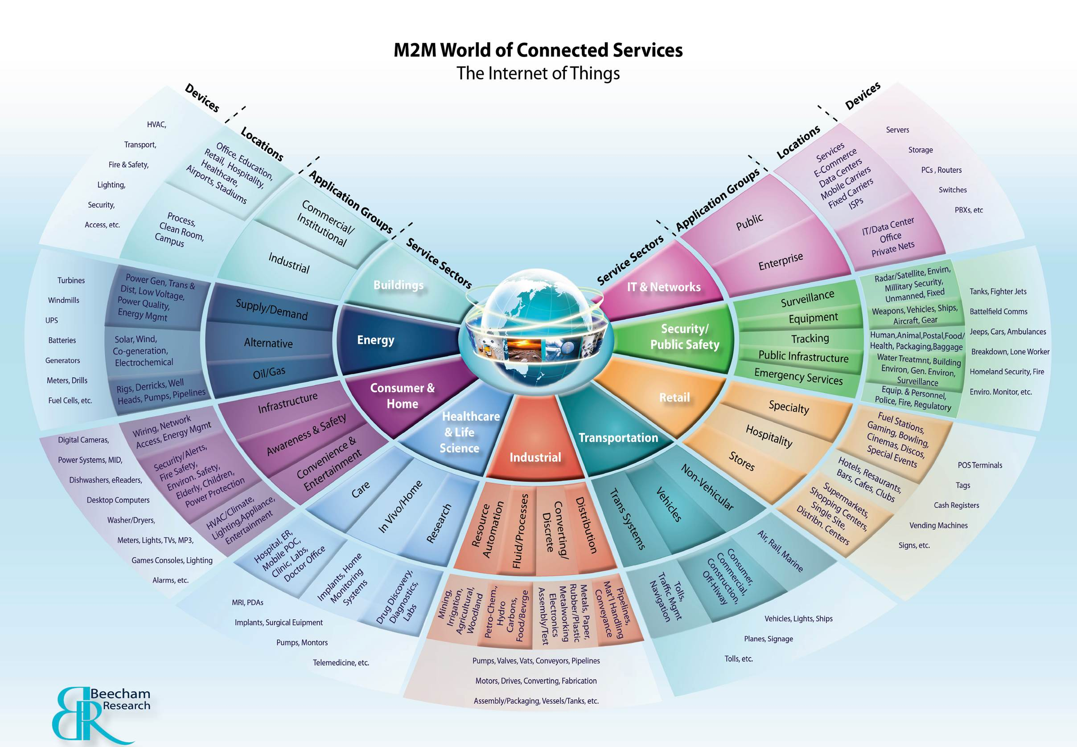
IF YOU ARE INTO DATA, THE IOT HAS IT

Slide 4
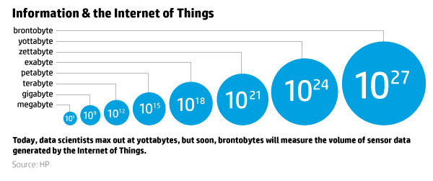
WHY THIS EXAMPLE?
GET READY FOR BRONTOBYTES!!

Slide 5
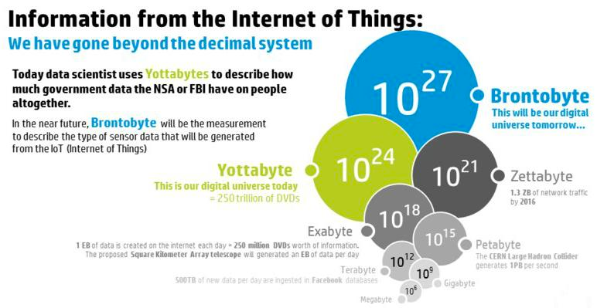
WOW, HOW BIG IS A BRONTOBYTE?

Slide 6
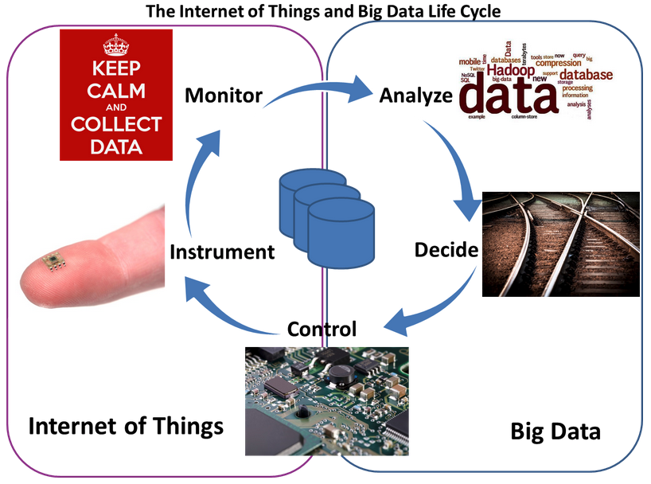
This much data will require a fast OODA loop
Image courtesy http://www.telecom-cloud.net/wp-content/uploads/2015/05/Screen-Shot-2015-05-27-at-3.51.47-PM.png

Slide 7
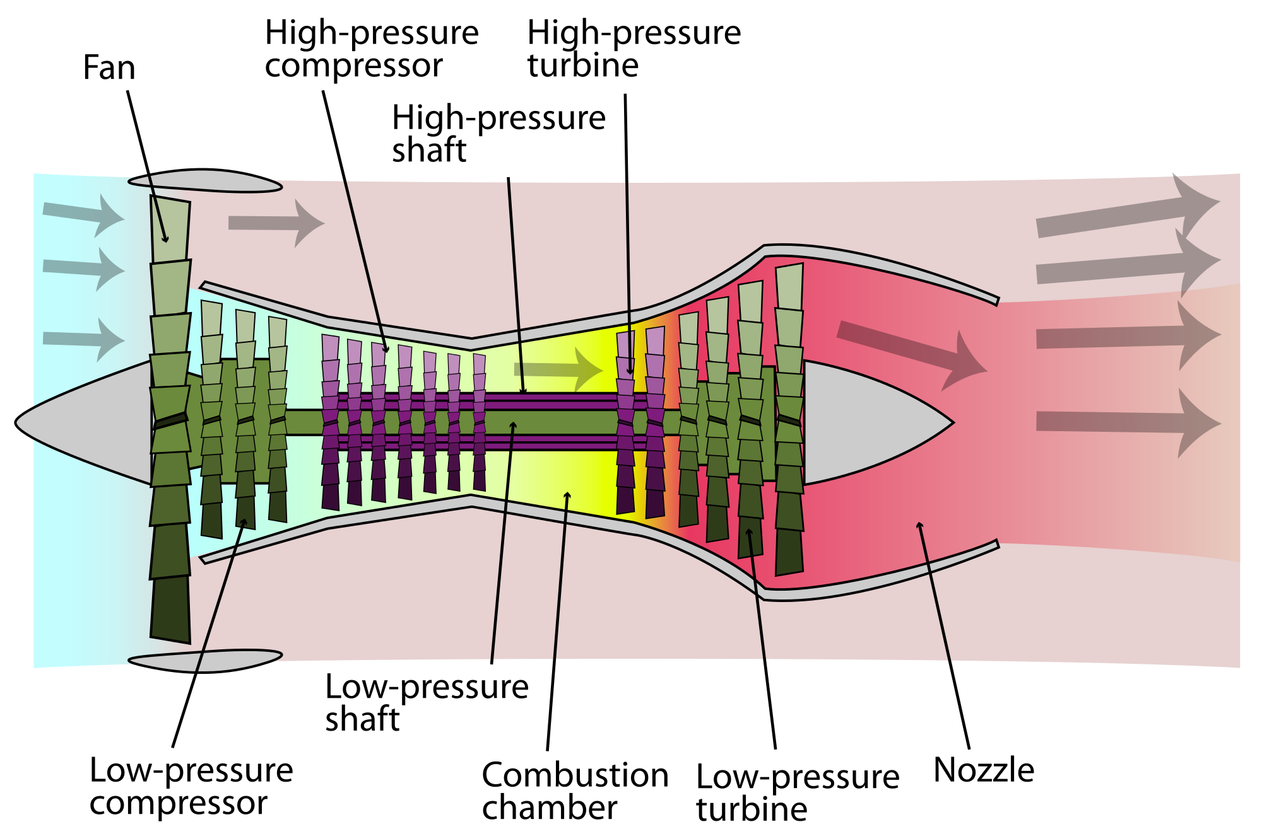
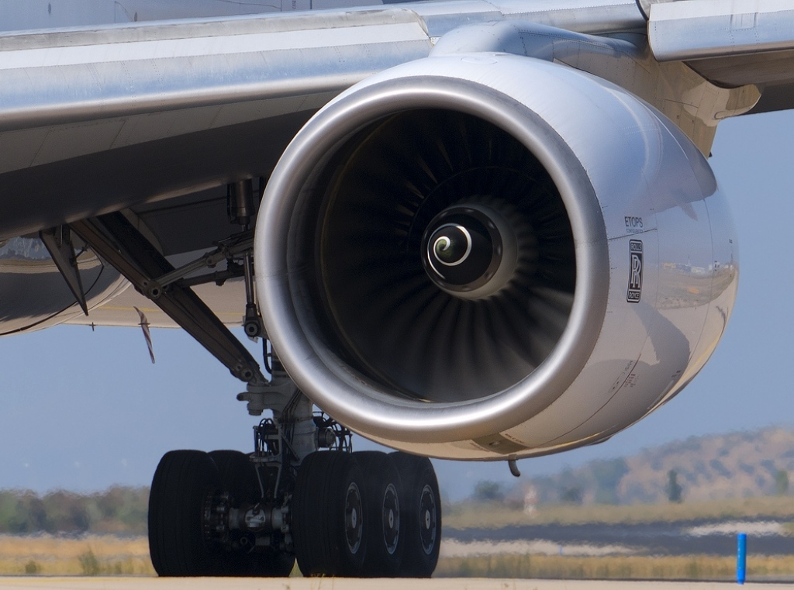
EXAMPLE FROM THE IOT
Domain: Prognostics and Health Management
Machine: Turbofan Jet Engines
Data Set: A. Saxena and K. Goebel (2008). "Turbofan Engine Degradation Simulation Data Set", NASA Ames Prognostics Data Repository
Predict Remaining Useful Life from Partial Life Runs
Six operating modes, two failure modes, manufacturing variability
Training: 249 jet engines run to failure
Test: 248 jet engines

Slide 8
INCORPORATING PRIOR STATE
One option:
Phase Space Embedding
Drawbacks:
Incorporates knowledge from small number of prior states
Curse of dimensionality
Disentangling the dynamic core: a research program for a neurodynamics at the large-scale
MICHEL LE VAN QUYEN
Biol. Res. v.36 n.1 Santiago 2003
http://dx.doi.org/10.4067/S0716-97602003000100006

Slide 9
KALMAN FILTER
Notes:
Kalman filters take into account knowledge about all prior time steps predictions and measurement to calculate current state.
Builds on prior knowledge that remaining useful life should decrease by one each observed cycle.
Another way to think about Kalman filters: When state variable goes from being discrete to continuous, an hidden markov model (HMM) becomes a Kalman filter.
Widely used in engineering and economics

Slide 10
OVERALL PIPELINE
Feature engineering
Signal processing, feature creation, feature selection
Regression Models
Supervised Machine Learning
Linear dynamical system
Kalman filter
Notes:
Regression model - think of it as a non-linear mapping from high dimensional signal space to (lower dimensional) observation space (one per regression model)
Kalman filter acts as both incorporating prior knowledge (dynamics) and ensembling results from multiple regression models (aka observations)

Slide 11
EXPLORATORY DATA ANALYSIS
Boolean Indexing

Slide 12
EXPLORATORY DATA ANALYSIS
Sample the data to local memory

Slide 13
EXPLORATORY DATA ANALYSIS
Use your favorite visualization tools
(Seaborn!)
Ugh, where are trends over time
Zero
Remaining
Useful
Life
Time

Slide 14
MODEL BASED DATA ENRICHMENT
Sensor measurements appear in clusters
Corresponding to operating mode!

Slide 15
FEATURE ENGINEERING
Use H2O k-means to find cluster centers

Slide 16
FEATURE ENGINEERING
Enrich existing data with operating mode membership

Slide 17
MORE FEATURE ENGINEERING
For non-constant sensor measurements within an operating mode,
Standardize each sensor measurement by operating mode
Based on the training data

Slide 18
TRENDS OVER TIME!
Time
Time
Before H2O Data Preparation
Ready for H2O Learning

Slide 19
MODELING - SIMPLE
Configure an
Estimator

Slide 20
MODELING - SIMPLE
Train an Estimator

Slide 21
KALMAN FILTER INPUTS
State: [Cycles Remaining, Rate of Change of Cycles Remaining]
State Transition: [[1,1],[0,1]] (takes [RUL,-1] -> [RUL-1, -1])
Observations: regression output of each model in ensemble
Observation Covariance: mean square error of each model on training data (diagonal matrix)
Initial State: [Mean of models, -1]
Notes:
State transition incorporate dynamics predictions

Slide 22
KALMAN - POST PROCESSING

Slide 23
SIGNAL PROCESSING + MACHINE LEARNING
Filtering, Convolution (integrals, differences, etc)
Time domain to frequency domain (Fourier) or other domain (wavelet)
Dynamic time warping for sequence similarity
Spatial-temporal analytics
Convolution Neural Nets and LSTM-RNN
Notes:
“Signal Processing is the science that deals with extraction of information from signals of various kinds. This has two distinct aspects -- characterization and categorization. Traditionally, signal characterization has been performed with mathematically-driven transforms, while categorization and classification are achieved using statistical tools
Machine learning aims to design algorithms that learn about the state of the world directly from data.
A increasingly popular trend has been to develop and apply machine learning techniques to both aspects of signal processing, often blurring the distinction between the two.”
http://mlsp.cs.cmu.edu/courses/fall2012/

Slide 24
RESOURCES
Download and go: http://www.h2o.ai/download
Documentation: http://docs.h2o.ai/
Booklets, Datasheet: http://www.h2o.ai/resources/
Github: http://github.com/h2oai/
Training: http://learn.h2o.ai/
This presentation and associated Jupyter notebook (look in 2016_02_23_MachineLearningAndKalmanFiltersForMachinePrognostics): https://github.com/h2oai/h2o-meetups/

Slide 25
THANK YOU

